Slide 1
Software Project Management
In the name of Allah, the Beneficent, the Merciful
Lecture 04 & 05:
Software Project Planning

Slide 2
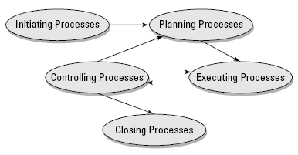
PMI Process Groups

Slide 3
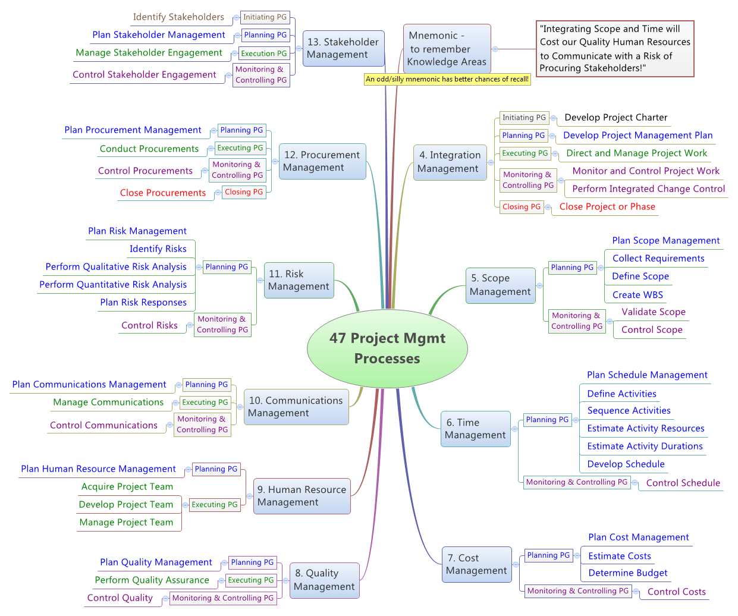

Slide 4
Project Planning
The planning process, determines how the project will move forward after the project feasibility, description, and charter are complete.
Planning isn’t a one-time deal. Planning is an iterative process that happens as many times as it must throughout the project life cycle.
The point of planning is to communicate exactly what you’ll be doing in the project. It’s a guide for all future project decisions.

Slide 5
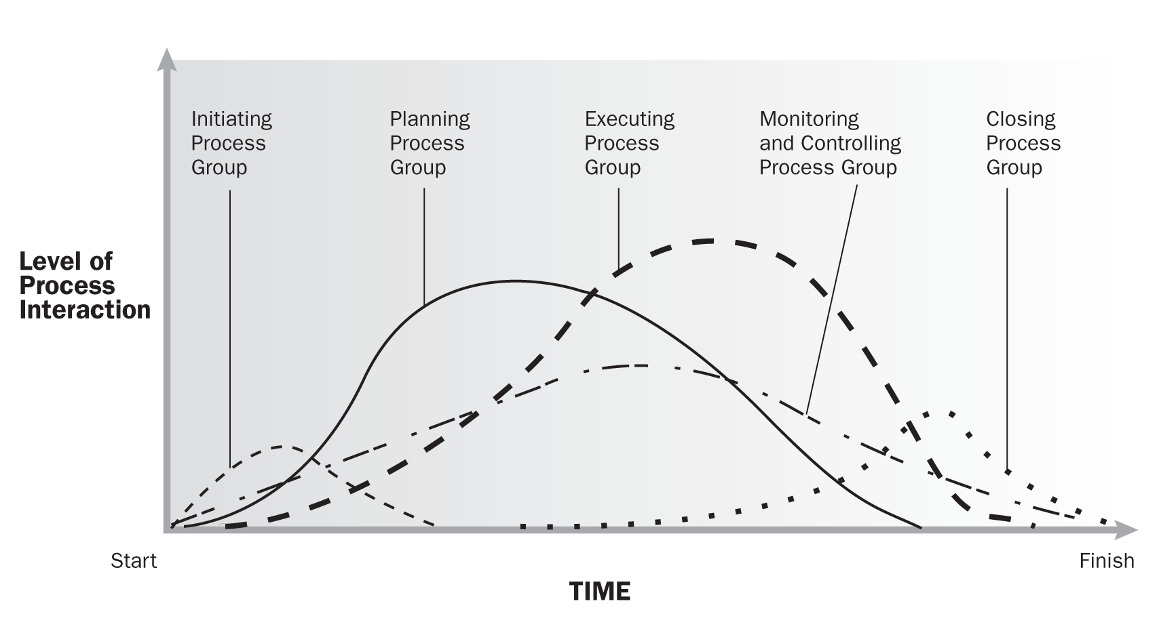
Project Process Groups

Slide 6
Why Plan?
Planning
reduces the risk of failure
increases the chances of success
planning coupled with control brings more predictability to the probable outcome of an endeavor

Slide 7
Why Plan?
“Can I plan in my head or should planning be documented on paper?”
Although planning is a necessity, documenting the plan (or planning on paper) is not always a necessity
it’s just the degree of rigor with which we plan (including documenting the planning activities) that is open to discussion.

Slide 8
Documented Plan
Be reviewed by others to see if any important aspect has been overlooked
Act as a point of reference for stakeholders
Facilitate control and performance evaluation
Facilitate validation of the planning parameters

Slide 9
Planning
The granularity of planning depends on
Duration of the endeavor
Number of resources employed
Complexity involved
Relationship between the duration, number of resources, and complexity
Geography of the project

Slide 10
Planning is defined as the intelligent estimate of resources required to perform a predefined project successfully at a future date within a defined environment

Slide 11
Planning Key Terms
Estimate: estimate is a prediction of the future
Resources : human resources,materials, methods, and machines
Project :a specific scope of work
At a future date: dates for executing the project are in the future and decided during the planning.
Within a defined environment: the environment in which the work will be performed.

Slide 12
Attributes that make software development projects unique
Output is not physical
Process inspection does not facilitate progress assessment
Software engineering tools have limited predictability
Professional associations in the software development field lack practice and behavior standards
Productivity and quality are dependent on human beings

Slide 13
General attributes of a software project
A project has a definite beginning and a definite end
The project deliverable is software and the related artifact
The activities in a software project may include:
defining the user
Defining software requirements
software design
software construction
software testing, etc

Slide 14
Plans Prepared In Software Project Management
Project management plan
configuration management plan
Quality assurance plan
Schedule
Induction training plan
Build plan
Deployement plan
User training plan
Hand over plan
Software maintanance plan

Slide 15
Project Scope Management
The processes to ensure that the project includes all the work required, and only the work required to complete the project successfully.

Slide 16
Project Scope Management
During planning phase, it includes:
Planning and Defining the Project Scope
Creating the WBS (Work Breakdown Structure)

Slide 17
Project Scope Management
There are two scopes within project management:
Product Scope
Project Scope

Slide 18
Product Scope
The product scope describes, lists, and categorizes all the features and components of the finished deliverable.
The things the customer sees.
NOTE: We already have an “Early Form of Product Scope” in the form of “Product Description”
Scope of a Product refers to the features, characteristics and functions of the product, service or result

Slide 19
Project Scope
The project scope describes the work that must be completed in order to complete the project.
The Project Scope is all about the project, it defines the requirements of products, the work required to create the product, and defines what is in the scope and what not.
Project scope refers to all the needs to be addressed in order to create the product, service or result.

Slide 20
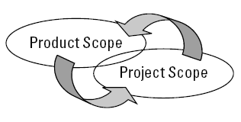
Project Scope vs Product Scope
Each scope depends on the other, and what happens in either scope affects the other.
Project Scope is more work-oriented, (the hows,) while Product Scope is more oriented toward functional requirements. (the whats.)

Slide 21
Complete Product Scope First
When the stakeholders are in agreement on the product scope, then you can focus on creating the software project scope.
The best way to determine the product scope is to analyze the concrete needs and expectations of the stakeholders.

Slide 22

Example-1:
Project: School Construction
Product Scope = This school building is the Product and the requirements for this product are known as Scope
Project Scope = you work to construct the school building within the given time, and budget, meeting all the client’s requirements by following the project management plans.

Slide 23
Stakeholders Need Assessment
Completing Stakeholder Analysis
Managing Stakeholder Objectives (Stakeholder Management)

Slide 24
Stakeholders Analysis
Stakeholder analysis is the process of determining who your stakeholders are and what their interests and concerns for their project are.
Persons or organizations, who are actively involved in a project or whose interests may be positively or negatively affected by the performance or completion of a project.
Those who perceive themselves affected by a decision, activity or the outcome of a project

Slide 25
Stakeholders Analysis
Stakeholder analysis isn’t just examining who the stakeholders are - but also their demands and wishes for the project deliverables. You’ve got to ask lots of questions

Slide 26
Stakeholders Analysis
Can you describe the conditions this deliverable will operate in?
What’s the opportunity this project will grasp?
What’s the main problem this software will solve?
How do you see the deliverable solving your problem?
What other software will this deliverable interact with?
What are the primary and secondary features of the software?
How will this software make the end-users’ jobs better or easier?
Are there other stakeholders that we should consider?
How do you see this deliverable benefiting your customer?

Slide 27
Managing Stakeholder Objectives
Don’t expect stakeholders to play nicely with each other. Like all people, stakeholders have individual personalities, and competing stakeholder objectives can haunt a project through its duration.
Sometimes, stakeholders don’t know exactly what they want and they’re counting on you to show them.
Stress to the stakeholder that you both must have a clear vision of what the project will create. Without a real grasp on the deliverables, writing an effective project scope - let alone creating an effective application - is impossible.

Slide 28
Managing Stakeholder Objectives
Knowing the sources of common conflicts
Schedules - know how their schedule is affected by your project.
Priorities - different priorities for different features.
Resources - people/things required for project.
Technical beliefs - arguments on technical possibilities.
Policies and procedures - Policies and procedures, both good and bad, exist for some reason — even if no one can explain what that reason is.
Costs - Unable to calculate or see the costs. “time is money”
Personalities - only become a problem when they prevent the project from moving forward.

Slide 29
Building the Software Scope
When you and the stakeholders have clear vision of where the project is going, you need a clearly defined set of requirements.
Not everything is really a requirement. Some facets of your software may be optional. You should try to identify, or at least prioritize, the things your project will create.

Slide 30
Regulation & Standards
You also need to know if your project is going to adhere to any Regulation(s) and/or Standard(s)
Regulation: A government imposed requirement, which specifies product, process or service characteristics, including the applicable administrative provision, with which compliance is mandatory
Standard: document established by consensus and approved by a recognized body that provides, for common and repeated use, rules, guidelines or characteristics for activities or their results, aimed at achievement of the optimum degree of order in a given context
E.g. size of a computer disk, or a QWERTY keyboard, and the ISO standards

Slide 31
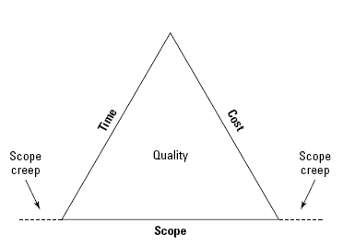
Optional Features
Use “Iron Triangle” to help stakeholders discover optional features.

Slide 32
Requirement Document
Requirement document identifies everything the project promises to create.
NOTE: A very detailed and well documented product scope can actually work as your requirement document.

Slide 33
Product Scope
Signing Requirements Document: You and the customer should sign off on this document so that everyone involved agrees that the project manager and the customer agree on their roles and expectations for the project deliverable.

Slide 34
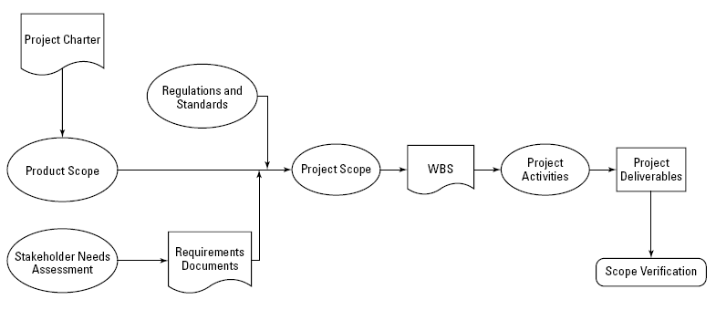
Creating Project Scope
Validation
Validation is concerned with checking that the system will meet the customer’s actual needs, while verification is concerned with whether the system is well-engineered, error-free, and so on.

Slide 35
Project Scope Statement
Deliverables e.g., defines what the project will create for the customer
Assumptions e.g., you’ll have access to test the software on customer’s network
Exclusions e.g., you are not responsible for initial data entry
Influences e.g., business processes, other applications, departments

Slide 36

Work Breakdown Structure
A Work Breakdown Structure (WBS) is visual representation of everything the project will create.
Typically WBS includes things (deliverables, components, etc) and not activities.

Slide 37
Creating Your WBS
Break down the scope into major bucket of things the project will create. For Example:
Web Deliverables
Database Deliverables
Documentation Deliverables
Project Management Deliverables
Decompose these deliverables into smaller units or work packages

Slide 38
Why Create WBS
Activity Definition
Cost Estimating
Cost Budgeting
Resource Planning
Risk Management Planning

Slide 39
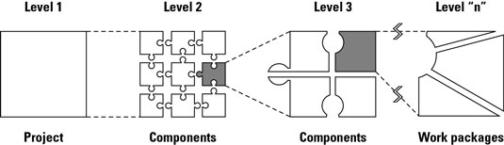
WBS Construction

Slide 40
Types of WBS:
Deliverable-oriented WBS
built around the project’s desired outcomes/ deliverables
Process-centered WBS
Organized in phases or steps in a process rather than by deliverables
E.g. design, development, testing, user-acceptance and so on for a software project

Slide 41
Types of WBS (cont..)
Hybrid WBS
– It mixes process and product
– For instance: life-cycle phases at higher levels
Organizational WBS
– Higher levels are organizational units
– Lower levels collect the work which is under the responsibility of a Unit
Geographical WBS
– Higher levels are geographically distributed teams (e.g. NY team, Trento Team)
– Lower levels collect the work under the responsibility of a team

Slide 42
What is ‘100% rule’?
important WBS design principles is called the 100% Rule
Complete WBS represents all the deliverables of the project e.g. PM Plans as well
Rolling up would cover ALL of the work that project team ever does
technique ensures that team does only requirements related work, nothing more, nothing less

Slide 43
Each lower level decomposition must represent all of the work of the higher-level element
Conversely, all higher-level scope must be reflected in one of the lower-level elements
Ensures: All of the scope has been captured and nothing unnecessary is included

Slide 44
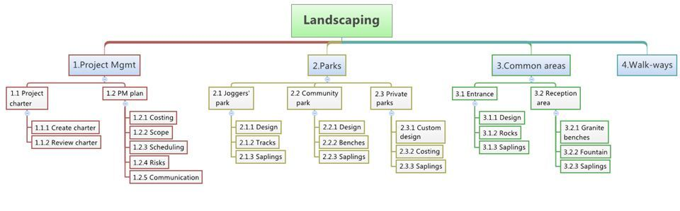
Example:

Slide 45
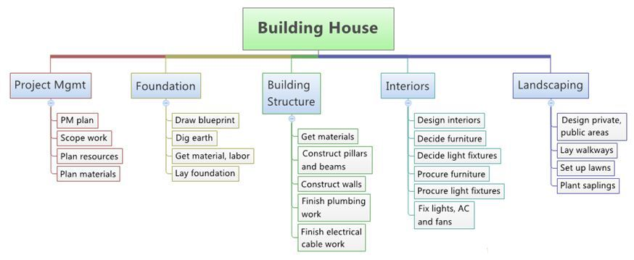
Example:

Slide 46
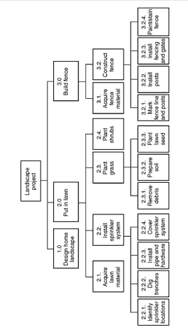
Example:

Slide 47
Example

Slide 48
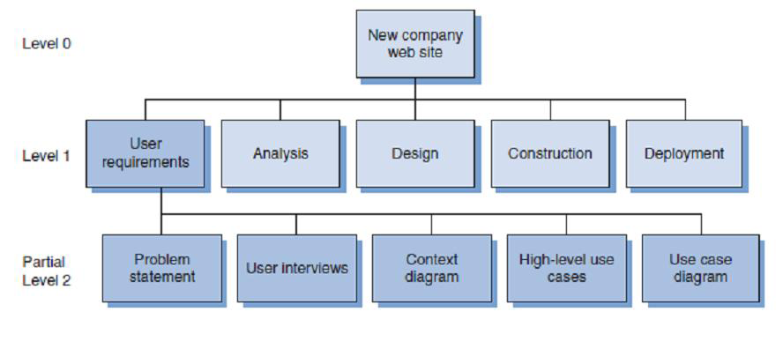
Example: Process-Based WBS

Slide 49
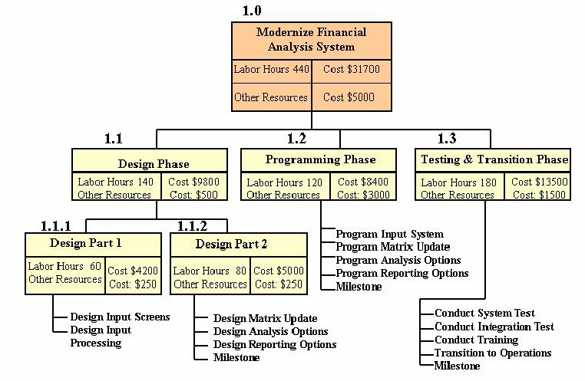
Example:

Slide 50
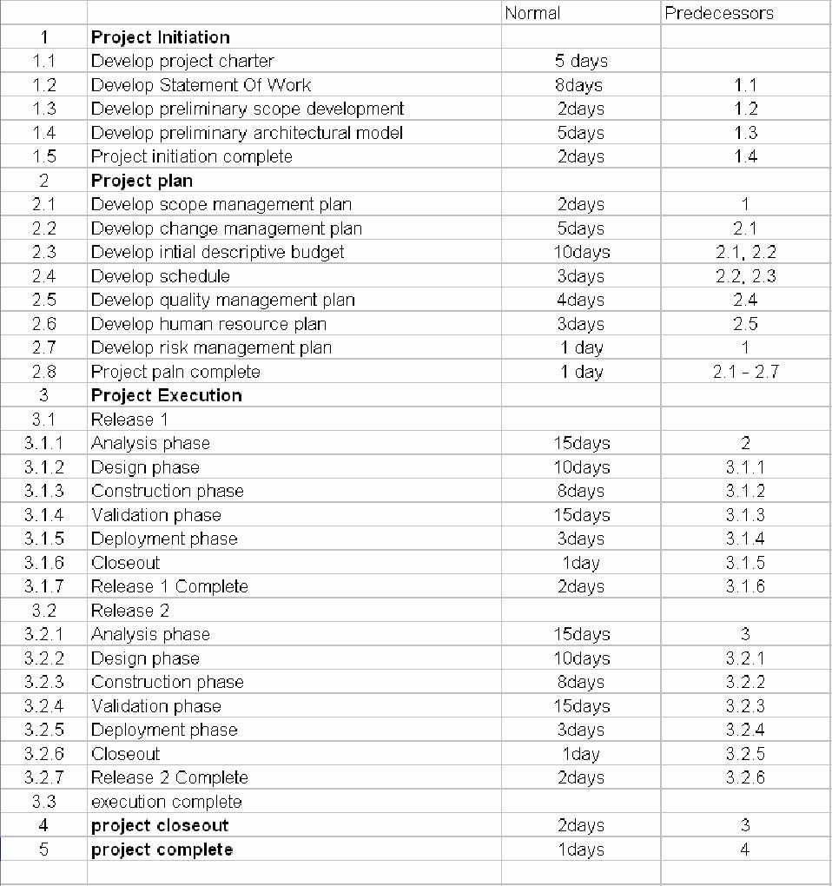
Example:

Slide 51
Summary
Planning and Defining the Project Scope
Creating the WBS (Work Breakdown Structure)

Slide 52
Scope Management
Planning Process Group
Plan Scope Management
Collect Requirements
Define Scope
Create WBS
Monitoring & Controlling Process Group
Validate Scope
Control Scope
Reference: PMBOK 5

Slide 53
Software Project Management
Process Groups
Knowledge Areas
Initiating
Planning
Executing
Controlling
Closing
Scope Management
Time Management
Cost Management
Quality Management
Human Resources Management
Communications Management
Risk Management
Procurement Management
Integration Management
Stakeholder Management

Slide 54
Reference:
Chapter 5: Software Project Planning
Chemuturi, M., & Cagley, T. M. (2010). Mastering software project management: Best practices, tools and techniques. J. Ross Publishing.

Slide 55
Q & A

